Slide 1

Minor Project
7th Semester
OFFENSIVE IMAGE CONTENT DETECTION SYSTEM
THROUGH TEXT EXTRACTION
AND IMAGE PROCESSING
Vaidehi Gupta (005) Kanishka Arora (007) Shally Kumar (008) Aiman Fatima (022)

Slide 2
PROBLEM STATEMENT
One of the main problems of the Internet is the presence of harmful (e.g. pornographic) or even illegal (e.g. pedophilic) contents which is not suitable for all age groups. The amount of this non-desired material is growing at an increasing rate.
To design a system which would detect the offensive image and text content present in the form of an image against social media standards and block them from posting on any social media platform.

Slide 3
Statistics-Online Offensive Content
28%
32%
12%
9%
Pornographic Content
Pornographic Content
2017 |  |  |  | 2018
Pedophilic Content
Content related To CyberBullying

Slide 4
Previous Work/ Literature Survey
In this section, literature review of papers published in the past 10 years in the field of image processing along with machine learning and its applications for recognition of offensive content in images like adult content, violence, etc. have been discussed.
A lot of researches have been made using artificial intelligence and its subset machine learning as well as data mining techniques to present many different systems.
It can be seen that Support Vector Machines (SVM) is one of the most commonly used technique in this domain [1][4][10]. It is also used along with other technique Bag-of-words method [9]. Other algorithms that is very popular is Convoluted Neural Network (CNN) wherein many different models for the same have been implemented. For instance, Fast R-CNN-optimizes classification and bounding box regression tasks. Faster R-CNN-additional subnetwork to generate region proposals. YOLO-object detection via a fixed-grid regression

Slide 5
SHORTCOMINGS
Handwritten text and complex text font cannot be accurately recognized.
Text extraction from images is not very prevalent.
Video object detection is still done manually

Slide 6
What we will contribute ?
What We Will Contribute?
Text Extraction from images
Classification of offensive content
Offensive content analysis in videos

Slide 7
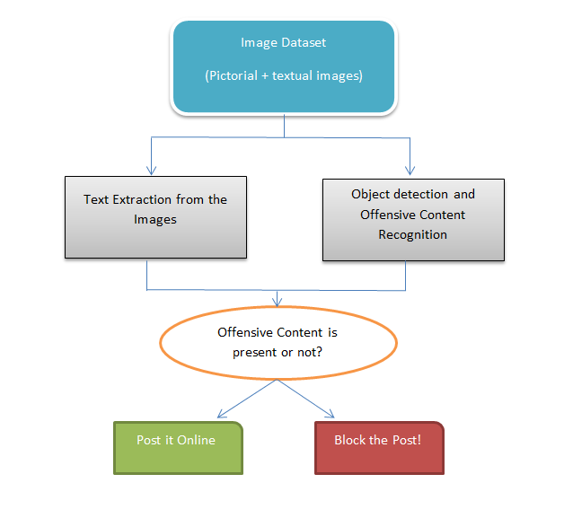
Proposed Workflow

Slide 8
USE CASES
Adult Content Filter Used to filter content for Children
Detecting CyberBullying To easily detect and resolve cases of CyberBullying
E-Commerce Websites Detection of offensive content in logos and product images

Slide 9

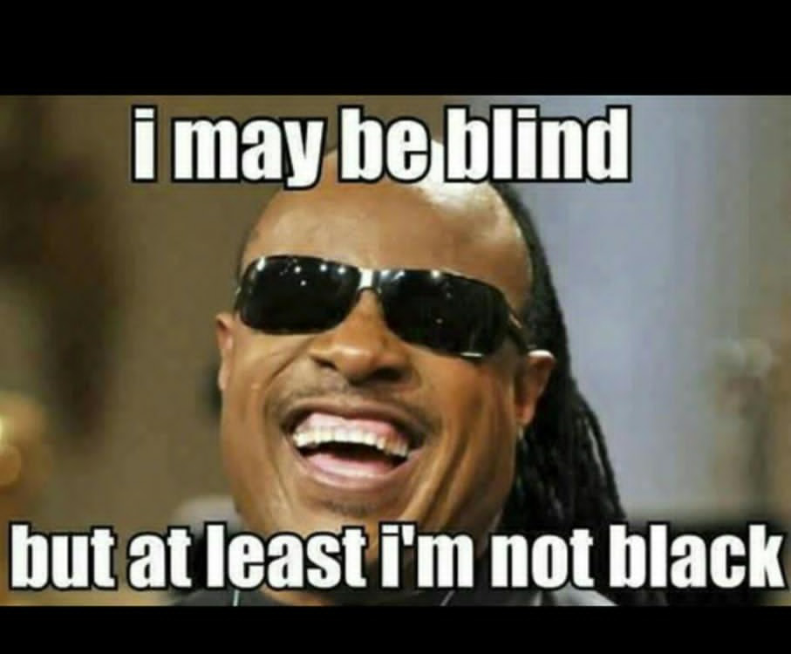

Offensive content
Violent image (Normal Text)
Racist text in image
Hate text in an image

Slide 10

EXAMPLE
Offensive -
Block
When you about to nut and they tell you to please leave the funeral
Verified to Post
Image with text
Text extracted from image

Slide 11
THANK YOU

